Slide 1



MS Access
Class VIII
lab 26

Slide 2


Datasheet
A datasheet is a simple way to look at your data in rows and columns without any special formatting

Slide 3
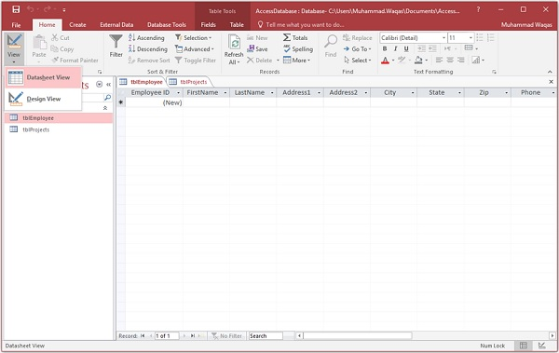
Add Data Into Tables
step: 1

Slide 4
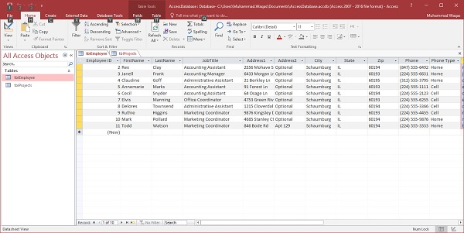
Add Data Into Tables
step: 2

Slide 5
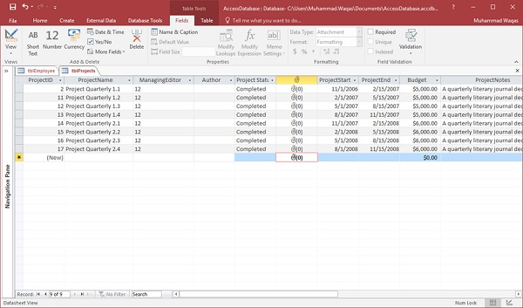
Add Data Into Tables
step: 3

Slide 6
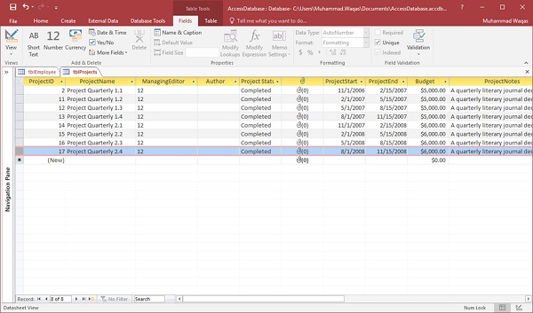
Add Data Into Tables
step: 4

Slide 7
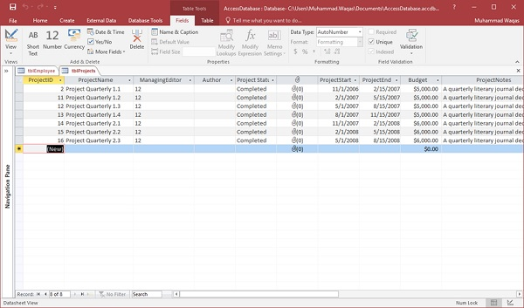
Add Data Into Tables
step: 5

Slide 8

Query
A query is a request for data results, and for action on data

Slide 9
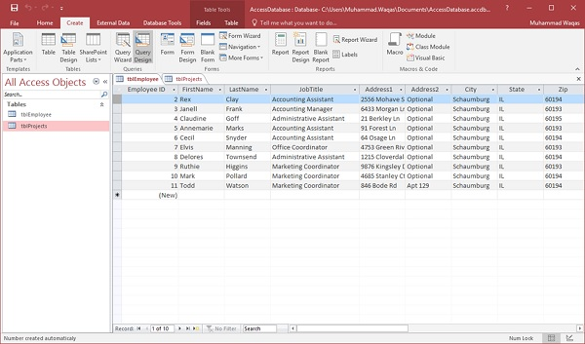
Select Query

Slide 10
Select Query

Slide 11
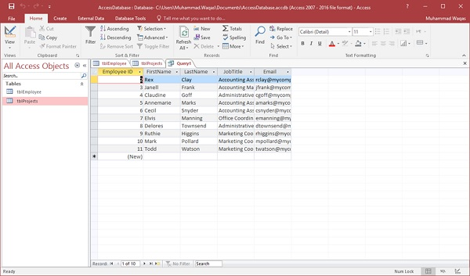
Run Select Query

Slide 12



